Slide 1
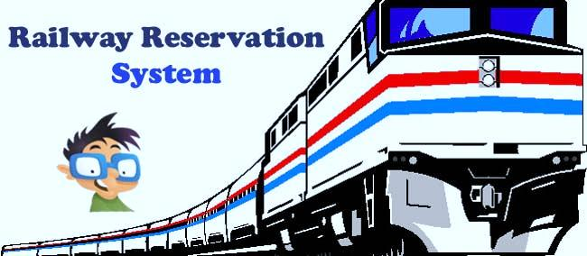
PRESENTATION ON
RAILWAY RESERVATION SYSTEM

Slide 2
Presented by:
NAME – MD. SIFAT HOSSAIN ID - 153402342
NAME - MUNSHI SAYED-UZ-ZAMAN ID - 141352032

Slide 3
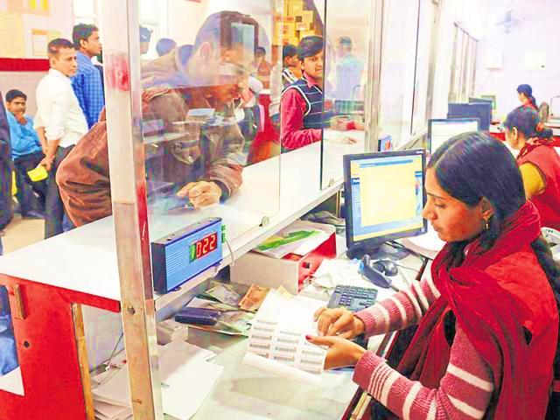
RAILWAY RESERVATION SYSTEM

Slide 4
INTRODUCTION
This system is basically concerned with the reservation of railway tickets to the passengers.
In this we are discussing that how the reservation is done.
What are the rules and regulations and procedure for a reservation?

Slide 5
ENTITIES
In this project we are going to include all the entities related to reservation
Booking
Canceled
Fare
Passenger_details
Personal_details
Seat
Tickets
Trains

Slide 6
FEATURES
Searching of data is easy.
Passengers don’t have to wait for a long time.
Information is accurate.
It is a fast process.
The system should be able to cancel a reservation.

Slide 7
Requirement
HARDWARE
REQUIREMENT
SOFTWARE
REQUIREMENT
Printer
Normal PC
CPU – Intel Core 2 Duo E7300
RAM – 512MB (MIN)
Hard Disk – 80GB
Operating System – Windows XP(MIN)
Windows 2000/ XP/ or Higher version
MS-SQL Server2000/2005
PHP My-Admin
MS-Internet Explorer

Slide 8
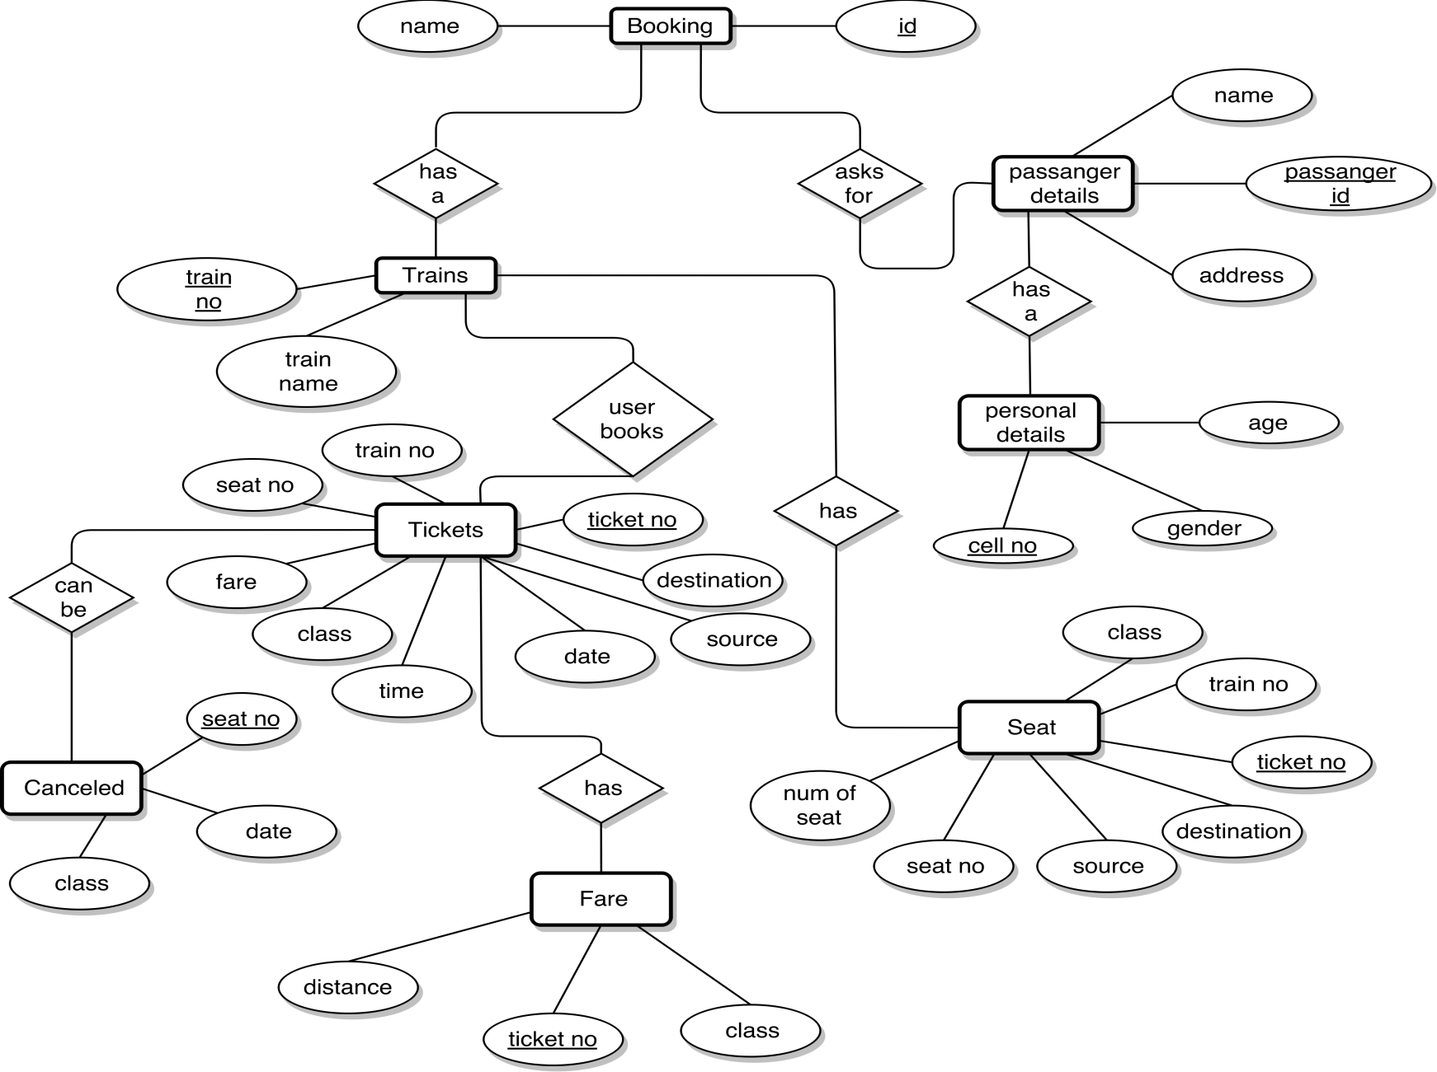
ER DIAGRAM

Slide 9
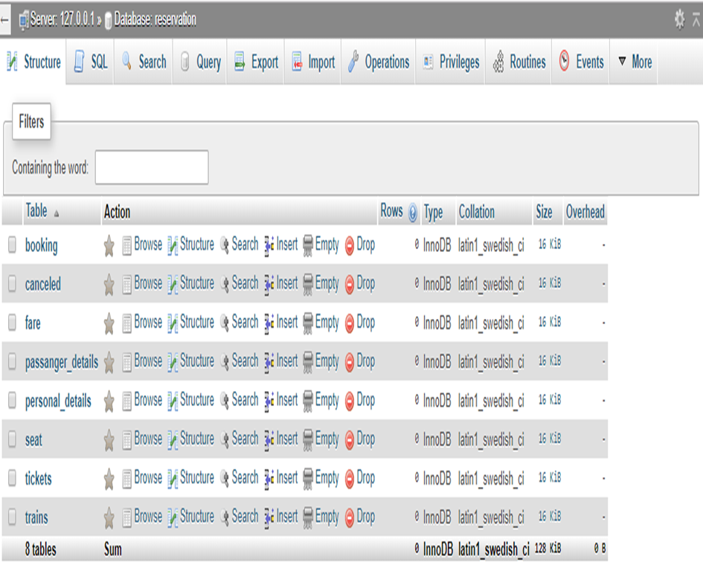
RAILWAY RESERVATION SYSTEM FULL DATABASE

Slide 12
ADVANTAGES DISADVANTAGES
Without waiting in long line one can easily book a ticket.
We can cancel a reservation
If you don't have internet access, online booking does not work
Some time server is busy.

Slide 13
CONCLUSION
Generally , it all depends on your requirements . But most of the booking system make your life simpler. If we use this reservation system we can save our important time.

Slide 14
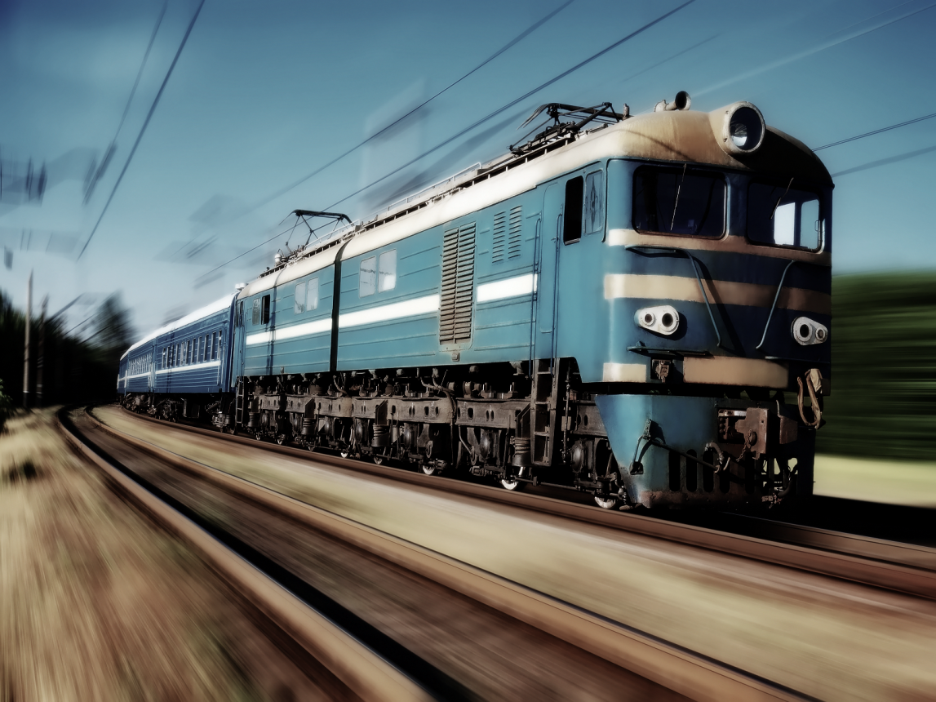
Thank you everyone

